Slide 1
Resolution of insurance claims arising out of the Canterbury earthquakes
Specific advice should always be obtained before relying on any aspect of the content of this presentation or associated materials.

Slide 2
Contents
  Canterbury earthquakes
  The Earthquake Commission
  Earthquake claims
  Dispute resolution
  Proposed earthquake tribunal

Slide 3
The Canterbury Earthquakes
4 September 2010
  7.1 magnitude earthquake at 4.30 am outside of Christchurch
    No fatalities
22 February 2011
  6.1 magnitude earthquake at 12.51pm earthquake in the close to the centre of Christchurch
    185 fatalities
Combined the earthquakes created the biggest insurance event in New Zealand history and, at the time, the 4th most expensive insured global natural disaster to ever occur.

Slide 4
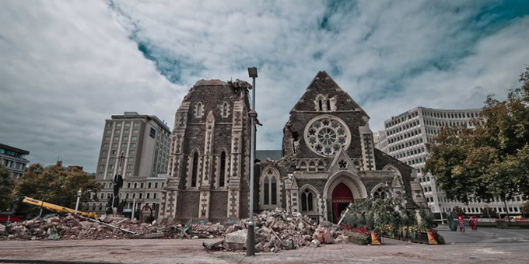
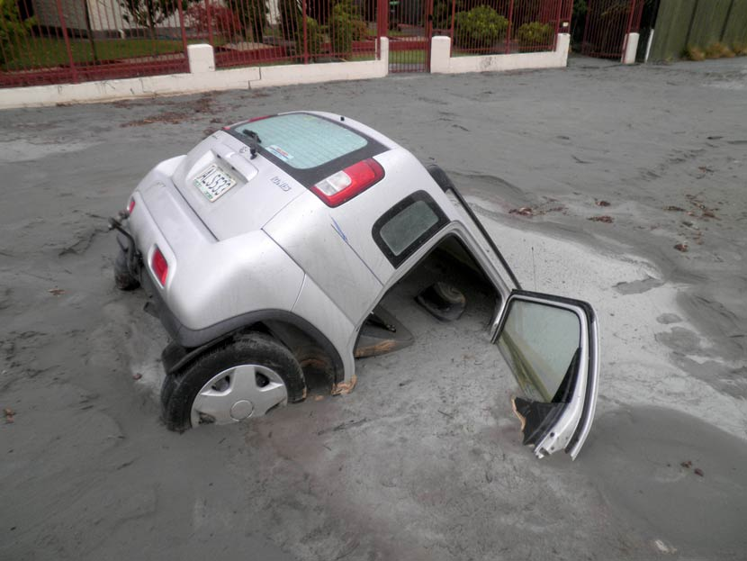
Destruction from the Canterbury earthquakes
Christchurch cathedral after the February earthquake
Many areas of the city suffered severe liquefaction

Slide 5
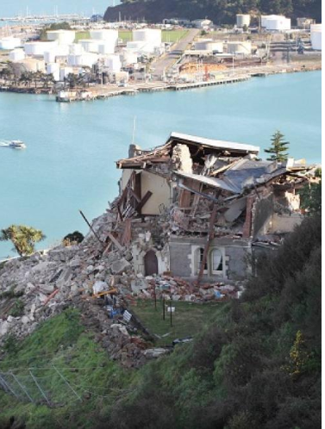


Overview of Earthquake Commission (EQC)
  EQC is a New Zealand Crown entity
  EQC invests in natural disaster research and provides insurance to residential property owners
  Residential homeowners automatically have EQCover if they have a current private insurance policy that includes fire insurance
  EQC covers;
    Earthquakes
    Landslips
    Volcanic eruptions
    Hydrothermal activity
    Tsunamis
  Maximum cover is $100,000 plus GST
    GST in New Zealand is 15%

Slide 6
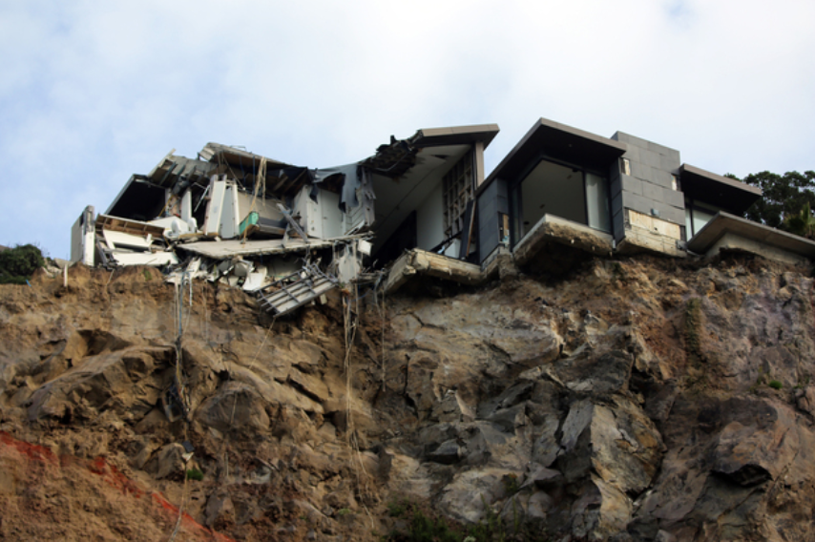
New Zealand’s Court Hierarchy
Supreme Court
Court of Appeal
High Court
An earthquake-damaged home in the Christchurch suburb of Sumner
Appeals from the earthquake tribunal will be by way of leave to the High Court
District Court
Tribunals

Slide 7
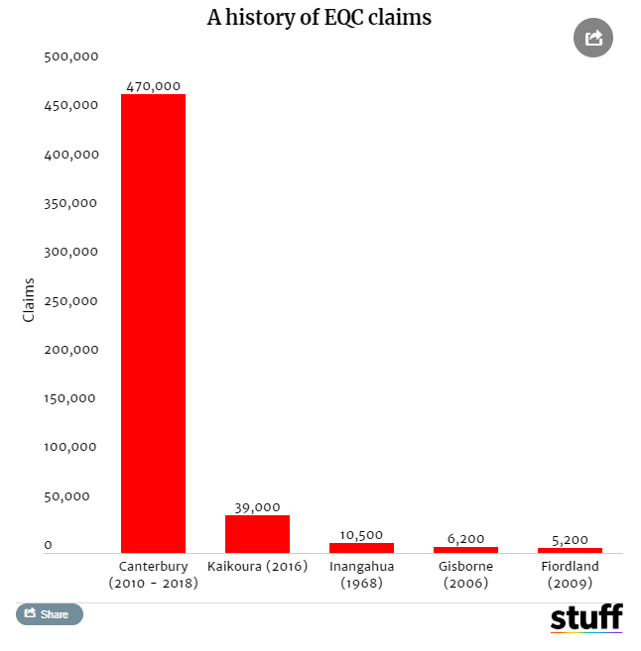
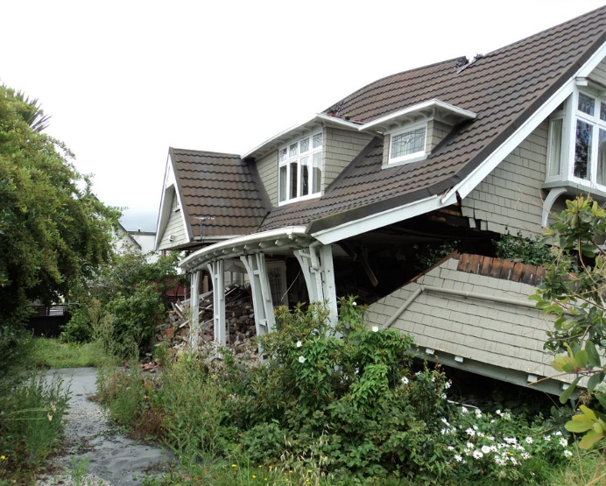
Earthquake Claims
  470,000 (residential) claims to EQC
  168,000 (residential and commercial) claims to private insurers
  Earthquake claims have been resolved using a range of options including:
    Direct negotiation
    Mediation
    District Court
    High Court List
As at February 2019

Slide 8
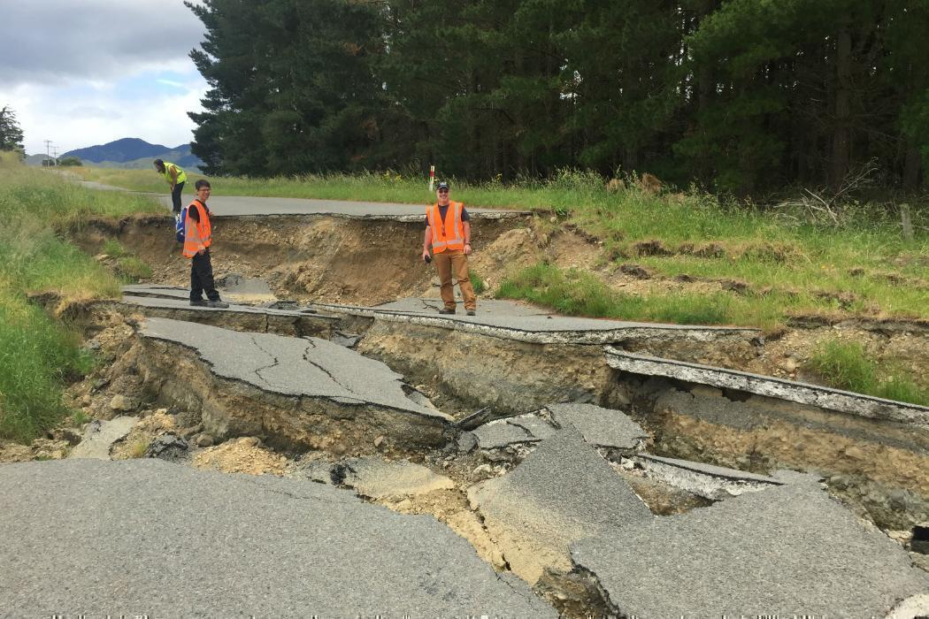
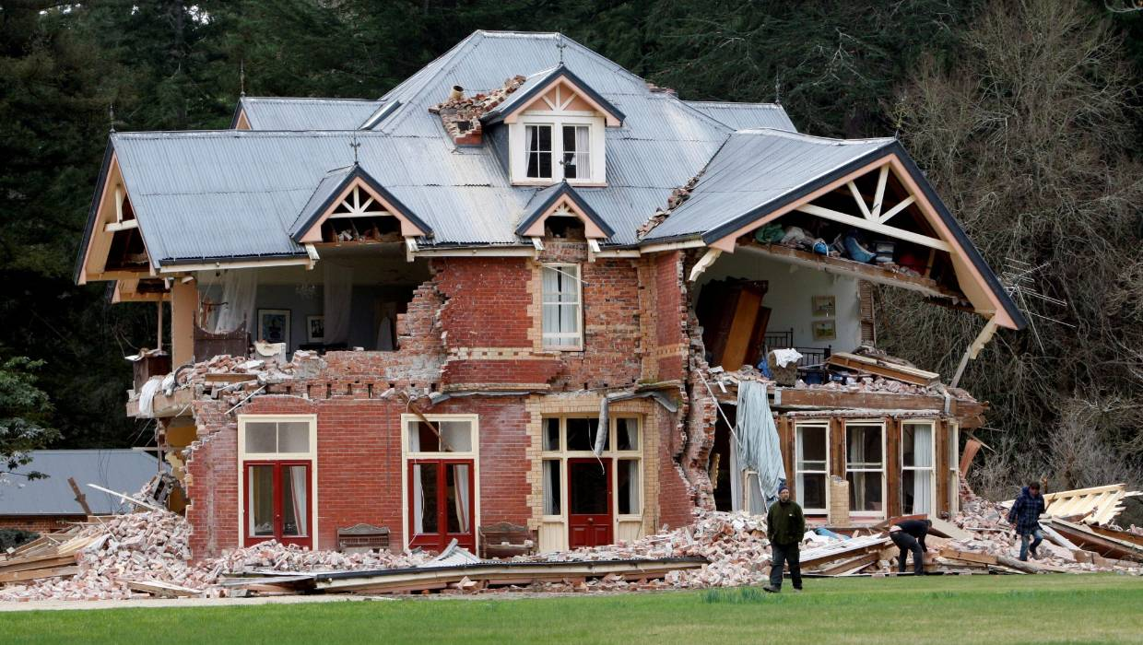
High Court – Earthquake List
  The High Court set up a specific list for hearing earthquake claims
  As at 30 September 2018:
    1,279 earthquake related proceedings had been filed since the list was created
    There were 559 remaining active proceedings
Case disposals for years ending 30 September
Year | Yearly Filings | Judgment issued | Settled or Discontinued | Percentage resolved
2012 | 24 | 2 | 1 | 100%
2013 | 180 | 20 | 28 | 100%
2014 | 154 | 9 | 59 | 98%
2015 | 81 | 9 | 86 | 94%
2016 | 316 | 2 | 125 | 67%
2017 | 271 | 7 | 178 | 26%
2018 | 253 | 4 | 184 | 3%
 | 1279 | 53 | 661

Slide 9
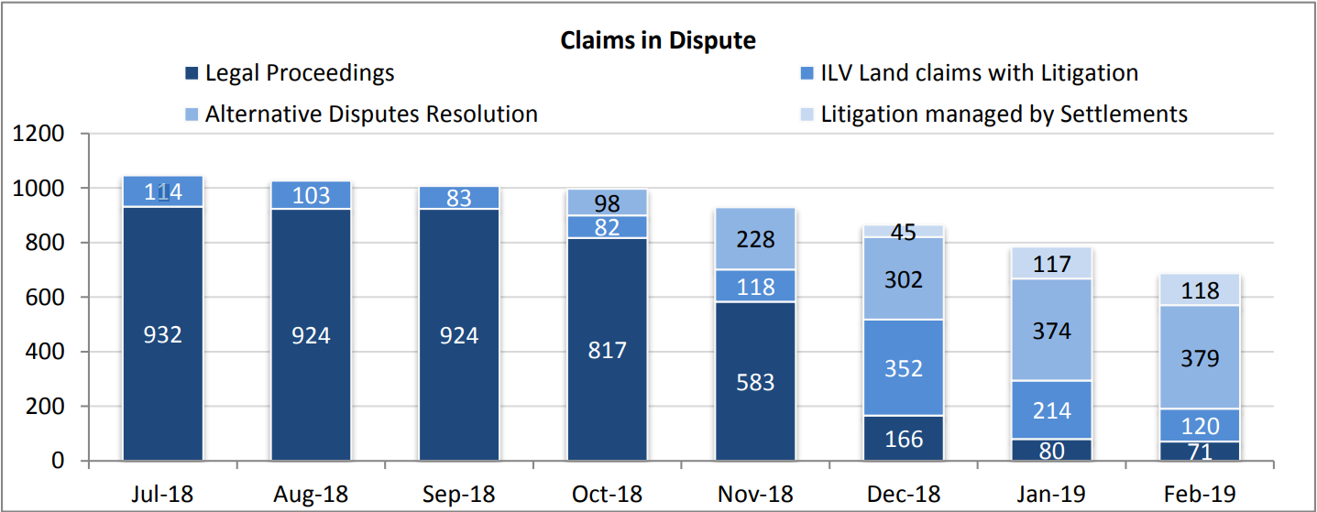
Canterbury EQC Claims: Disputes
Source: EQC Feb 19 Performance Dashboard

Slide 10
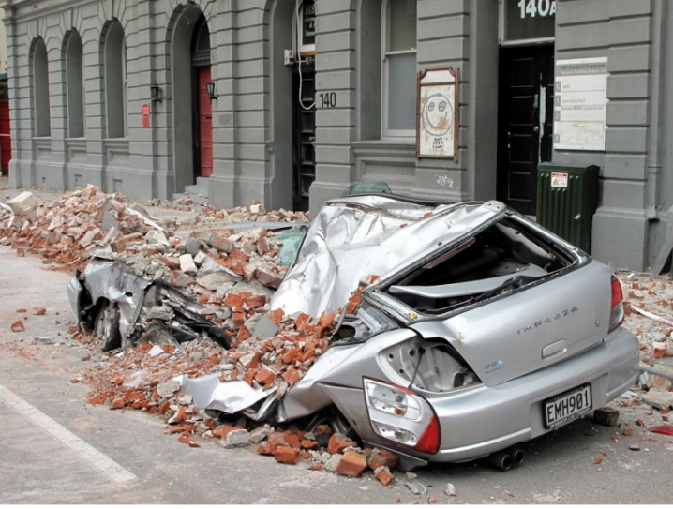
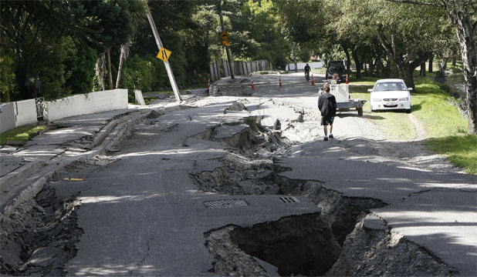
Proposed Tribunal
  The Canterbury Earthquakes Insurance Tribunal is intended to provide fair, speedy, flexible and cost–effective resolution of disputes.
  An independent judicial body.
  Will have jurisdiction over ‘Canterbury Earthquakes’ that occurred up to 31 December 2011. Disputes currently in court proceedings can transfer to the tribunal.
  Power to have claims transferred to the District or High Court if the claim poses:
    Undue complexity
    The claim is novel
    The subject matter is related to a matter of proceedings already before the court
  Some concern as to whether the tribunal will be effective given the scale of most remaining unresolved insurance claims.
  Proposed tribunal remains under consideration by a Parliamentary select committee.

